Slide 1



Paper ID: 22 Uncovering Temporal Trends of Desolation Among Social Media Users: A Data-Driven Analysis
Ateeq Ur Rehman Butt
Department of Computer Science
National Textile University, Faisalabad, Pakistan
3rd International Conference on Computational Intelligent Systems 2024
(ICCIS2024)

Slide 2
Contents
Introduction
Motivations
Novel Contributions
Proposed Methodology
Experimental Results
Conclusion

Slide 3
Introduction
Desolation is a growing public health issue linked to loneliness and isolation.
It affects mental and physical health, with ties to chronic illnesses like diabetes and heart disease.
Estimated to impact 350 million people globally (WHO).
National statistics highlight its connection to major depression and anxiety disorders.
Often called a "silent epidemic" due to widespread but underreported impact.
Social media platforms like Twitter enable real-time tracking of desolation-related sentiments.
Combines data mining and NLP to analyze emotions, supporting timely mental health interventions.

Slide 4
Limitations of Previous Studies
Traditional methods (surveys, interviews) lack real-time, temporal insights into desolation.
Limited focus on specific emotional phases, such as Phase A (desolation) and Phase B (loneliness).
Social media data for emotional analysis is underutilized, leading to fragmented insights.
Key situational factors (e.g., societal shifts, global events) impacting desolation are often overlooked.
Multimedia expressions (emojis, GIFs) conveying emotions are generally ignored in prior studies.

Slide 5
Motivations & Contributions 0f the Study
Temporal Trend Analysis: Tracks fluctuations in desolation expressions over time using timestamps from Twitter posts.
Multi-Modal Data Collection: Integrates both textual and non-textual data (emojis, GIFs) for a richer emotional dataset.
Advanced Preprocessing: Uses enhanced preprocessing and stemming techniques to improve classification accuracy.
Targeted Sentiment Classification: Employs a classifier focused specifically on desolation-related keywords for precise analysis.
Public Health Insights: Provides data-driven insights on desolation trends to inform timely public health interventions.

Slide 6
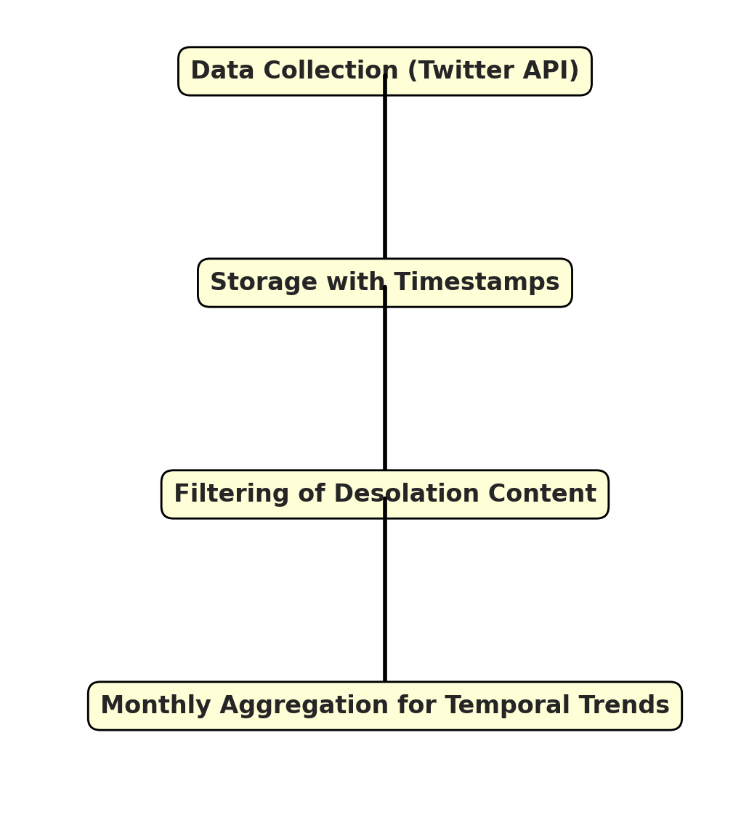
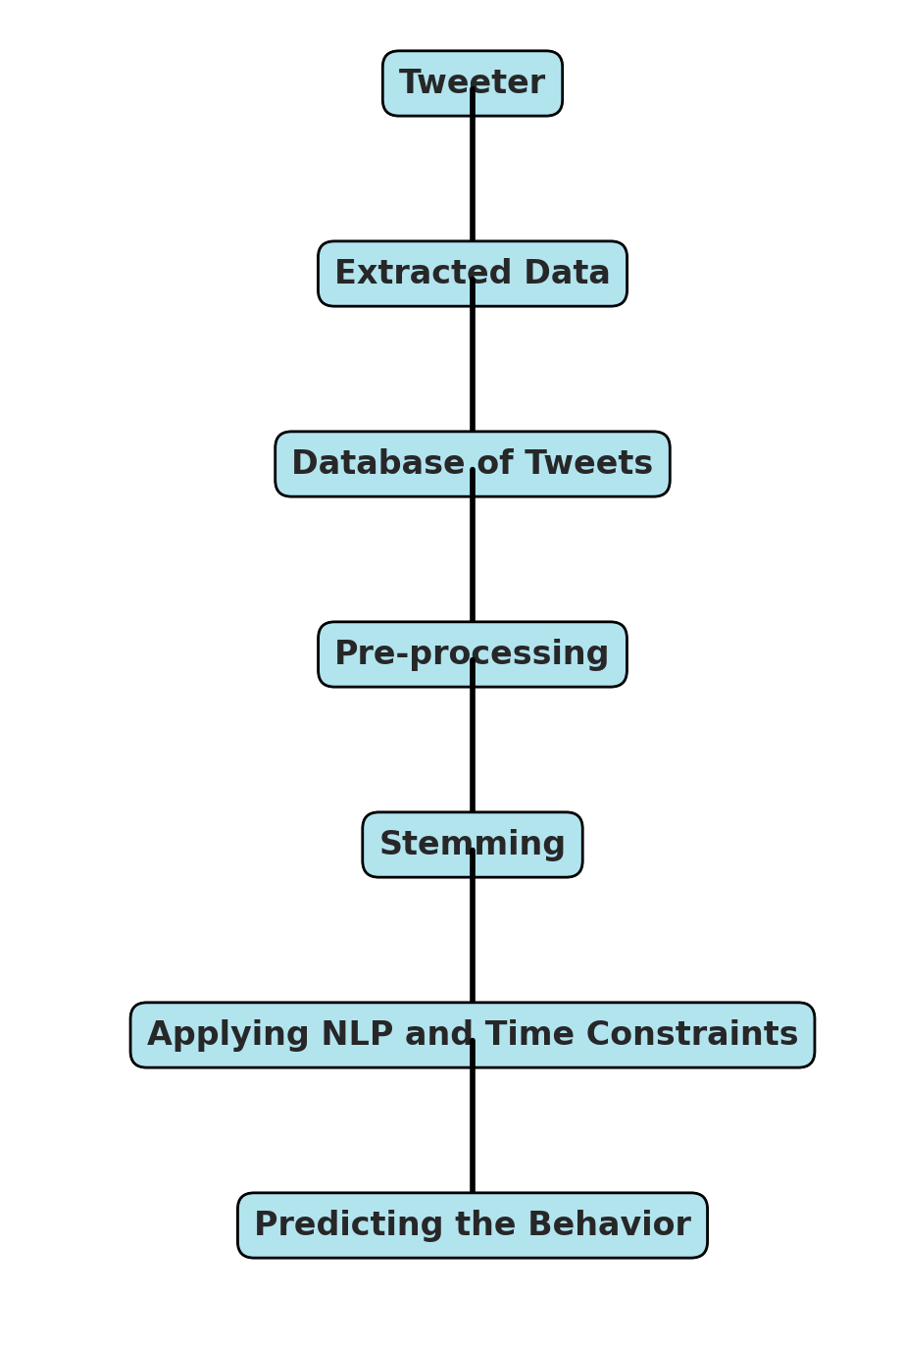
Proposed Methodology

Slide 7
Proposed Methodology
Data Collection: Twitter data gathered via API, focusing on keywords associated with desolation and positive emotions.
Pre-processing: Removed stop words and irrelevant data, resulting in a cleaned dataset for accurate sentiment analysis.
Stemming: Applied stemming to reduce words to root forms, standardizing language for NLP analysis.
Natural Language Processing (NLP): categorizes tweets based on desolation-related keywords and timestamps, enabling trend analysis.
Temporal Analysis: Tracked monthly fluctuations in desolation sentiment, observing increases, decreases, or stability over time.

Slide 8
Results & Discussion
Data Analysis: Collected tweets analyzed for desolation sentiment trends, stored systematically for insights into fluctuations over time.
Monthly Trends: Observed desolation sentiment peaks on Mondays, with a decline toward weekends, indicating potential links to work and social pressures.
Quarterly Analysis: Detected a gradual, month-to-month increase in desolation-related sentiments, with February and March showing over a 10% rise.

Slide 9
Results & Discussion
Sentiment Polarity: NLP analysis revealed 60% of "lonely" references were negative, highlighting a predominance of negative mental health expressions.
Implications: Rising negative sentiment and consistent desolation trends emphasize the need for public health awareness and mental health interventions.
Study Limitations: Limited internet access and the informal language on social media can reduce representativeness and complicate sentiment analysis.
Future Work: Suggestions include using multimodal analysis (textual, image) and enhanced algorithms for better context and sentiment interpretation.

Slide 10
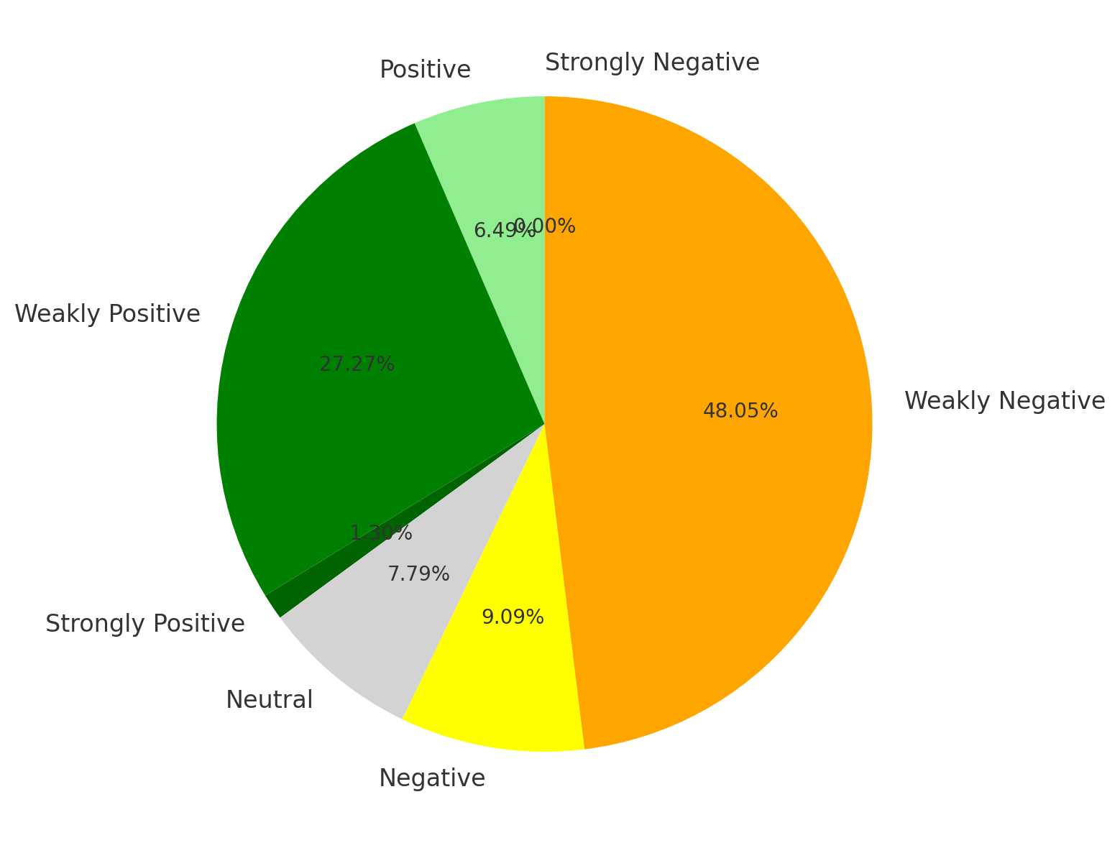
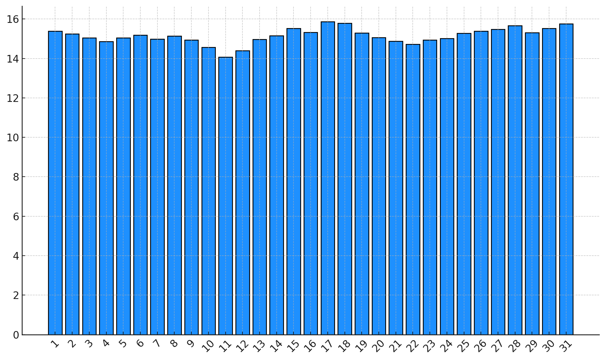
Results & Discussion
Monthly Distribution of Desolation-Related Tweets
Polarity Distribution of the Word ”Lonely” in Tweets

Slide 11
Conclusion
Emotional Insight: Social media serves as a rich source for analyzing public sentiment, especially for mental health insights.
Desolation Tracking: Methodology tracked desolation trends via Twitter posts, showing higher desolation expressions early in the week.
Sentiment Analysis: NLP categorized desolation-related content into positive, negative, or neutral, with a predominance of negative sentiment.
Implications for Mental Health: High negative sentiment indicates a need for mental health support, validating social media mining for public health insights.
Future Directions: Advancements could include multimodal analysis (text and images) and improved algorithms to interpret informal language.

Slide 12
Thank you

